Slide 1
Approaches to Measuring Openness
Isabella Peters,
ZBW – Leibniz Information Center for Economics
Göttingen, 27.3.2019
Notes:
20-25 Minuten
Thank you very much for the kind introduction. It is a great pleasure for me to be here and talk about approaches to measuring openness.
I have presented a very similar talk at the „LIS Bibliometrics 2019 Event: Open Metrics and Measuring Openness” hosted by the British Library in London earlier this year.
In the former talk and in this talk I would like to speak about two topics: the first one is about the approaches that have been introduced to measuring openness.
The second part of the talk will tackle the question why it makes sense (or not) to measure openness at all.
But there will be a third question which I would like to discuss with you….and we will see what this is at the end of this talk.

Slide 2
How to measure openness?
Indicators
Quantity (or: output or productivity)
# publications
Performance (or: impact or quality)
# citations, Journal Impact Factor, H-Index
Structural
# co-authors, cited disciplines
Process (or: doing open science)
Use of open source software, publish OA
System level (or: framework conditions)
Policies, tenure-decisions
Durieux, V., & Gevenois, P. A. (2010). Bibliometric Indicators: Quality Measurements of Scientific Publication. Radiology, 255(2), 342-351.
Lampert, D., Lindorfer, M., Prem, E., Irran, J., & Sanz, F. S. (2017). New indicators for open science-Possible ways of measuring the uptake and impact of open science. fteval Journal for Research and Technology Policy Evaluation, 44, 50-56.
Notes:
So, then let’s start with the first part on how to measure openness.
Traditionally, when it comes to measuring scientific work we can distinguish between indicators that are either concerned with the output, or the performance or the structure of research. Performance indicators are called impact indicators too, and sometimes these are even considered to reflect quality of scientific work.
These indicators are built from quantitative information and allow you to take a birds eye view so that you can get a deeper understanding of what is going on in scientific fields - and, of course, you can start to compare all actors in the scientific enterprise: researchers, institutions, and whole disciplines – if not more.
By looking up the literature on openness and open science I noticed that the discussion does consider other factors for measuring openness too. ---KLICK---
So, it is possible to consider whether researchers do things openly, such as publishing open access or using open source software.
Here also the definition of the EU has been considered that open science is about sharing research as early as possible instead of publishing as early as possible.
The other level which can be considered is the system level and whether the framework conditions are available to be able to actually do open science. This is where policies and strategies come into play, for example whether there are institutional policies that request research data management plans or that allow open practices to be counted for tenure decisions.
All indicators need context and interpretation – even if they are represented by numbers or shares. It doesn’t tell you very much if a researcher has 9 publications or 900. Somehow you need the story around that number to understand what this really means. Often comparisons help here.
So let’s see what our colleagues proposed in terms of measuring openness and how they would like to compare.

Slide 3
How to measure openness?
The Open Definition
Open means anyone can freely access, use, modify, and share for any purpose (subject, at most, to requirements that preserve provenance and openness).
http://opendefinition.org
Notes:
A pragmatic approach to an output indicator could be to take into consideration the open definition from the Open Knowledge Foundation and just count how many research products are equipped with the properties proposed in the definition. This matches quite well with the concept of open science since the open definition asks for scientific works for example to be published in the public domain or to be provided in machine-readable format.
I think this approach is quite straightforward – however, the concept of a research product must be understood as broad as possible to acknowledge the principle that sharing as early as possible is more valued than publishing as early as possible.
This is where another approach was thought to be of good help.

Slide 4

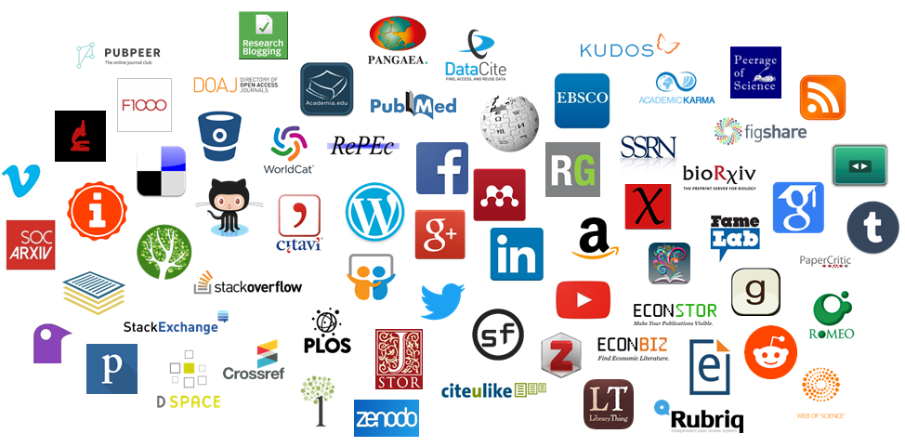

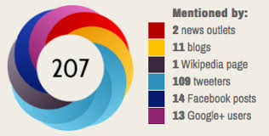
How to measure openness?
Altmetrics/ Social Media Metrics
Greater variety
Types of engagement
Types of research products
Types of stakeholders
MLE showed that “only few types of Open Science incentives and rewards are currently being implemented” (p. 99)
MLE on Open Science: Final Report -Altmetrics and Rewards (2018). https://rio.jrc.ec.europa.eu/en/library/mle-open-science-final-report-altmetrics-and-rewards
Notes:
In the beginning of the open science movement altmetrics or social media metrics were considered the perfect indicators to measure open science.
This is because they benefit from a greater variety in terms of types of engagement, research products and stakeholders. Hence they are able to “make visible new forms of scholarly communication; to broaden our understanding of the multiple types of social impact of research, for instance by mapping interactions of people and organisations; and to evaluate all influences of various types of scientific outputs and activities” (MLE, 2018).
---Klick--- However, although altmetrics can offer this diversity of information and therefore may reflect a more nuanced picture of research outputs, their performance and structure, often their quantitative nature is highlighted without taking much care of the context. Because of that and because of other challenges altmetrics face, such as their volatility, the European Expert Group on Altmetrics commissioned by the European Commission as well as other experts recommended to not use altmetrics as sole indicators for open science. The hesitance in using such alternative metrics was also revealed by the European Mutual Learning Exercise on Altmetrics and Rewards.
So, other types of measuring frameworks seemed to be needed.

Slide 5
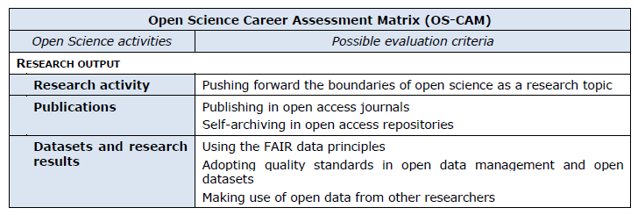
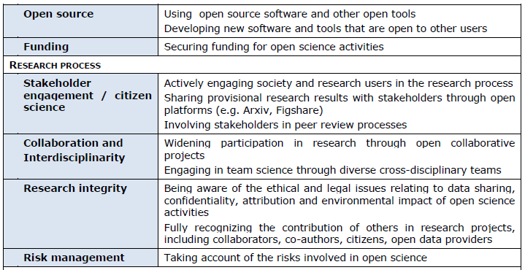
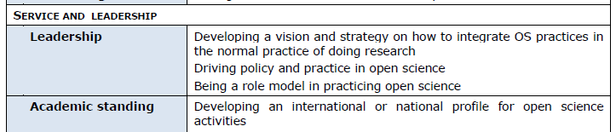
How to measure openness?
Open Science Career
Evaluation Matrix (OS-CAM)
Areas to be considered
Research output
Research process
Service and leadership
Teaching and supervision
Professional experience
O'Carroll, C., Rentier, B., Cabello Valdès, C., Esposito, F., Kaunismaa, E., Maas, K., ... & Lossau, N. (2017). Evaluation of Research Careers fully acknowledging Open Science Practices-Rewards, incentives and/or recognition for researchers practicing Open Science. Publication Office of the European Union. http://ec.europa.eu/research/openscience/pdf/os_rewards_wgreport_final.pdf
Notes:
Discontent with those alternative metrics, DORA and other criticism on research assessment exercises in the rear, expert groups and researchers called for more sophisticated approaches to be applied to open science, often combining quantitative and qualitative information.
The first example I would like to present for this type of measurement frameworks is the Open Science Career Evaluation Matrix, developed by a group of experts and issued by the European Commission.
The OS-CAM is a multi-dimensional approach and sets out to be a possible, practical move towards a more comprehensive approach to evaluating researchers through the lens of Open Science. The OS-Cam incorporates broader aspects of being an excellent researcher, such as service and leadership, research impact and contribution to teaching. The matrix illustrates how these broader aspects could be taken into account in the context of recognising researcher’s contributions to Open Science.
The criteria are expressed as “doing” Open Science in order to highlight the process-view we discussed in the slide before. This means, that there is room for interpretation and that the evaluation may rather take the form a narrative.
However, the matrix also includes indicators that consider performance or output of research and that could be translated into numbers.
Because this matrix particularly aims at evaluating individual researchers, weighting can only be part of the process - qualitative judgement must be the other part. Hence, the group of experts acknowledges that researchers cannot be properly evaluated by a number because their merits and achievements are a complex set of different variables, difficult to be summarised by a single figure.

Slide 6
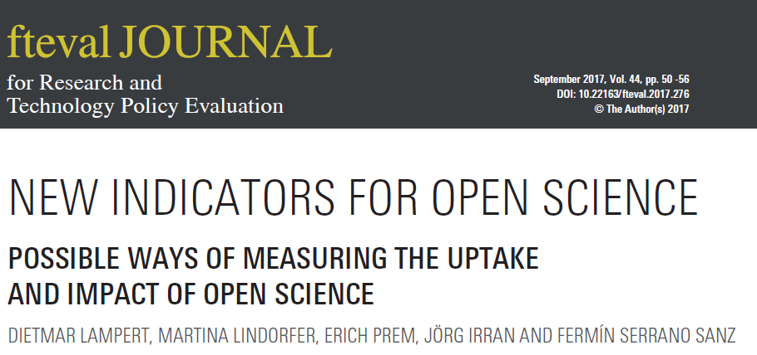
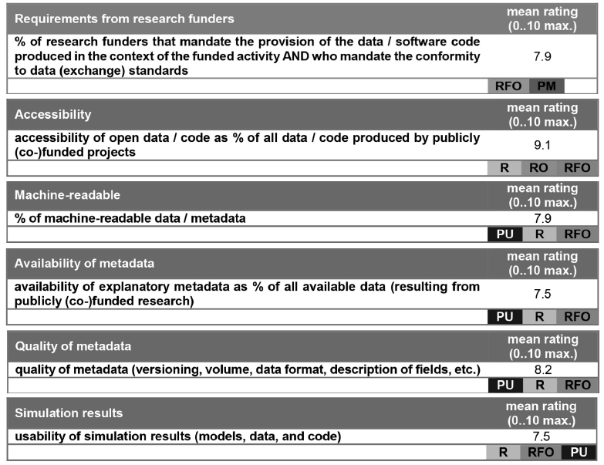
How to measure openness?
Areas to be considered
scientific process
conceptualisation, data gathering/creation
analysis
diffusion of results
review and evaluation
system level
reputation system, recognition of contributions, trust
open science skills, awareness
science with society
Notes:
A second proposal stems from a group of colleagues that has developed an inventory of indicators for open science also for the European Commission. They found indicators for the different areas of both the scientific process – so the doing of open science – and the system level, that is the framework conditions that are necessary to be able to perform open science.
In contrast to the Open Science Career Evaluation Matrix they take the measuring a little bit more literal and propose a variety of countable items, such as the percentage of machine readable data.
With their inventory of indicators they aim at measuring the uptake and impact of open science as well as monitoring the progress towards open science.
They also take into account how important a particular indicator can be for a specific stakeholder, for example the researcher, the research funder or the public.

Slide 7
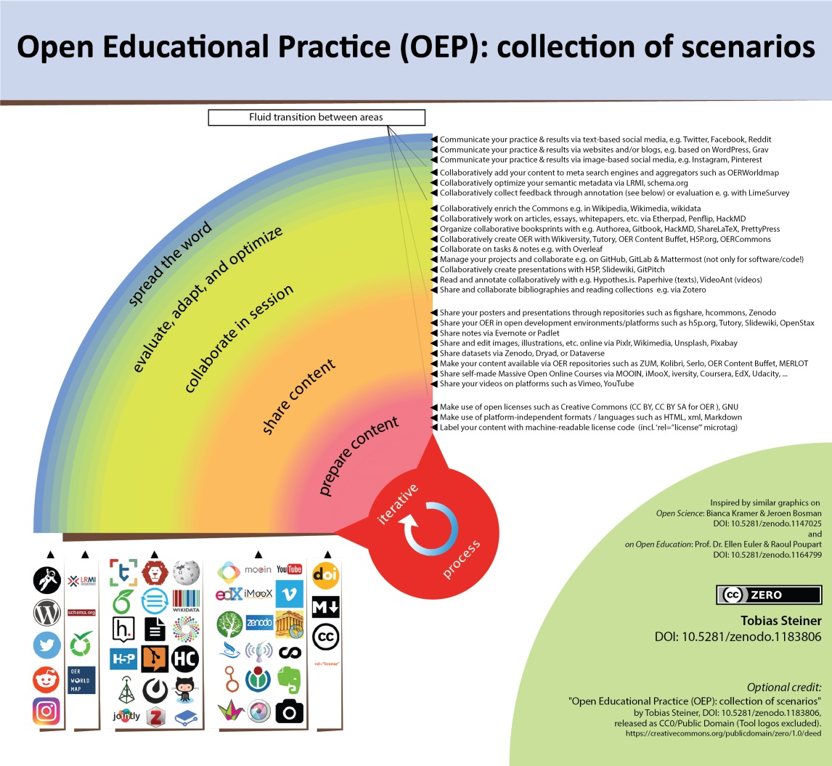
How to measure openness?
Doing open science
Steiner, T. (2018, February 23). Open Educational Practice (OEP): collection of scenarios (Version 1.01EN). Zenodo. http://doi.org/10.5281/zenodo.1183806
Notes:
But what does ‚doing open science‘ mean in reality? Is publishing open access enough to get a good mark in the open science career evaluation matrix?
Tobias Steiner has listed several scenarios that represent the „doing of open science“ with relation to the creation and sharing of open educational resources. Although this graphic is focused on open educational practice it illustrates quite well, what open practices may entail, even when it comes to research work.
Beginning with the stage of preparing a teaching unit (seminar, school lesson, etc. ) with corresponding open material (e.g. OER) (light red), we then move to the stage of sharing this unit and its content with the seminar, class, etc. online (orange). The next stage comprises making active use of the introduced content/material in a collaborative learning context as part of this seminar or working group) (yellow). This then might include, or be followed up by, shared instances of revising and optimization of the materials used, based on the experiences made and feedback gained during the session (green). Further contemplating on the experiences made, the teacher and/or the learners involved share their thoughts on these practices and examples online (blue).
The various open tools (ideally open source) that can be used in the various stages are shown as icons below the rainbow.
Tobias Steiner emphasizes that there is the possibility of an iterative process optimization which is also true for open research practices. This points towards the possibility of not necessarily going through Stage 1 (light red) in a linear way up to the last stage (blue), but rather making use of continuous back- and cross-referencing of neighbouring stages (indicated in the graphic via fluid color transitions).
The point that Tobias Steiner raises about the fluidity of scenarios and practices used in open science is very important – and in my opinion this is also a quality inherent to open science which makes it simultaneously appealing and flexible but also very challenging.
However, neither the open science career matrix nor the new indicators for open science take sufficiently into account that doing open science might be this iterative process or that those practices can be fluid.

Slide 8
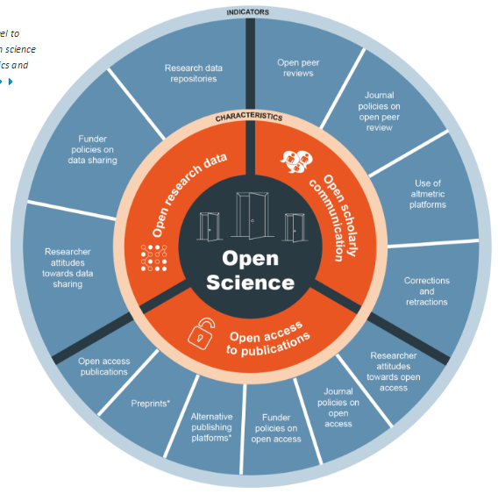
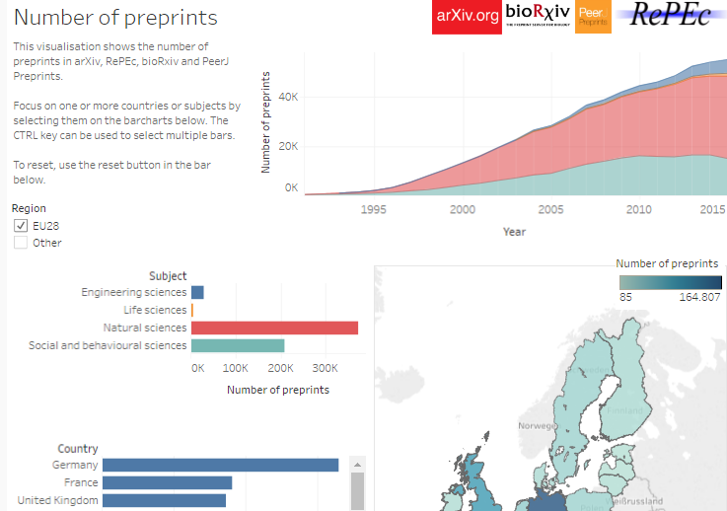
How to measure openness?
Open Science Monitor
http://ec.europa.eu/research/openscience/index.cfm?pg=home&section=monitor
Notes:
Open Science Monitor, which was published by the European Commission last year is another tool that allows for visualizing the uptake and impact of open science .
To some extent it overlaps with the work from Lampert et al. on the new indicators for open science which was shown before – but it also has some distinct features.
However, the open science monitor particluarly aims at showcasing success stories – or maybe better: success numbers – of open science.
For example it visualizes the number of preprints archived in repositories.
This monitor should support tracking of progress towards open science. But what maybe more notable is that the design of this monitor particularly encourages comparisons – of disciplines, countries, funders and so on.
And this is also the answer to the second question of this talk. Why should we measure openness?

Slide 9
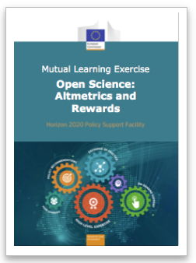
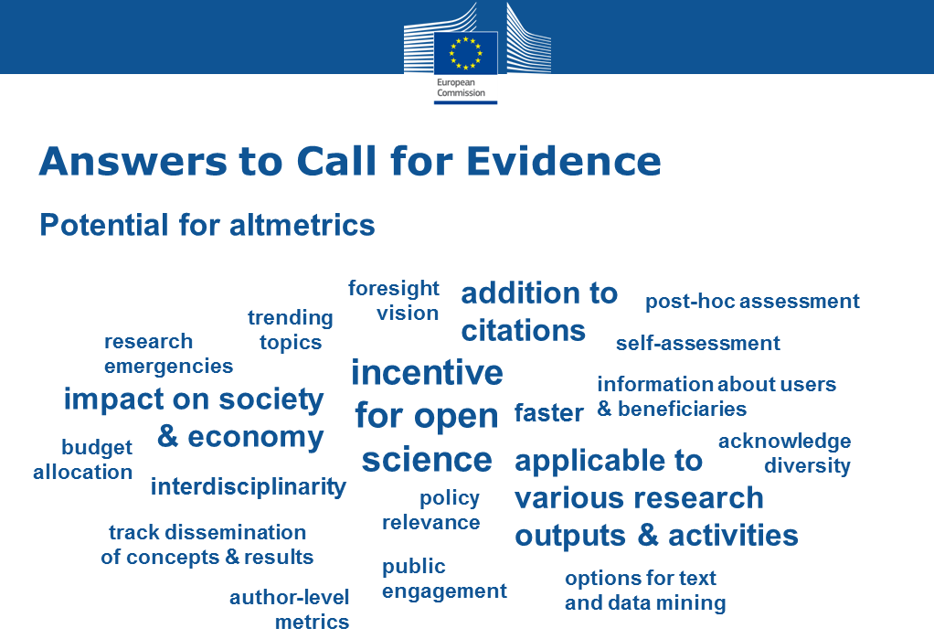
Why measure openness?
Sticks and carrots
“incentivize both research quality and open practices” (p. 26)
“linking open practices with performance evaluation has proven to be a very effective measure, especially when made mandatory” (p. 29)
MLE on Open Science: Final Report -Altmetrics and Rewards (2018). https://rio.jrc.ec.europa.eu/en/library/mle-open-science-final-report-altmetrics-and-rewards
Notes:
Because indicators are super incentives!
Apparently, researchers love carrots and do everything to get them (and they also do everything to avoid sticks).
And to harvest carrots you need to seed KPIs and other measurements.
This is what both the EUs Mutual Learning Excercies on Altmetrics and Rewards found out, as well as the Expert Group on Altmetrics.
Metrics and indicators are drivers of open science and should be integrated into the reward system of science. By rewarding researchers for behaviour related to open science, appropriate indicators are believed to be the best way to promote open science.

Slide 10
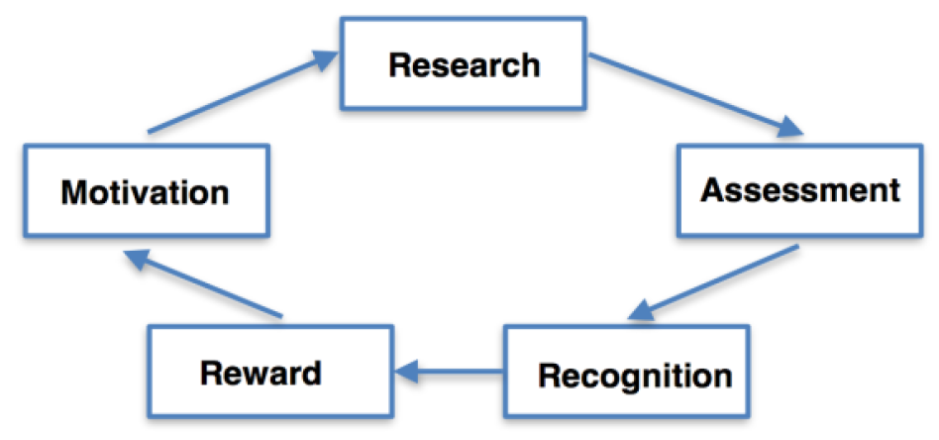
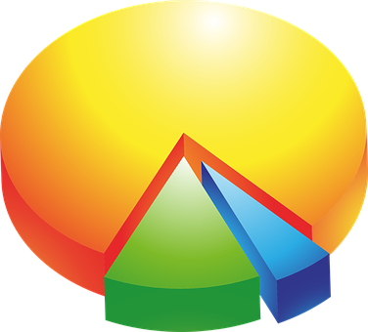

Why measure openness?
Research Reward Cycle
O'Carroll, C., Rentier, B., Cabello Valdès, C., Esposito, F., Kaunismaa, E., Maas, K., ... & Lossau, N. (2017). Evaluation of Research Careers fully acknowledging Open Science Practices-Rewards, incentives and/or recognition for researchers practicing Open Science. Publication Office of the European Union. http://ec.europa.eu/research/openscience/pdf/os_rewards_wgreport_final.pdf
Notes:
The European group that was concerned with the Evaluation of Research Careers fully acknowledging Open Science Practices recommended also stick and carrots.
“There should be a system in place that drives the virtuous cycle (positive Dynamik) summarised in the figure in the context of open science. There should be a clear focus on the researchers and on the quality of his/her scientific production more than on its quantitative measurement. Harmonisation of recognition and reward of researchers with basic aims of open science is a necessary condition for promoting research excellence.” (end of quote)
So, I guess I am done here with my presentation and talk. ---KLICK---
I have answered the two questions I had been given…you know now several ways how to measure openness and why it is important to measure openness, don‘t you?
Please let me show you a striking example of the use of indicators as incentives – and what effects they really have.

Slide 11
Why measure openness?
Research Rewards: Example from a European University
Points per publication = B x C x F x N
B = points, depending on type of publication and outlet (reutable or not)
C = collaboration factor (multiply with 1,25, if article has international co-authors)
F = university factor (multiply with 0,7 if 2 authors are from the home university, multiply with 0,6 if 3 authors, multiply with 0,5 if 4 and more authors stem from the home university)
N = if article has more than 100 authors, then multiply with 0,1
11
Notes:
This calculation is performed by a European university to grant bonusses for good research work.
So let‘s have a look what they consider to be good or valued work.
You get points for publishing in reputable journals. Okay that is common business.
Then those points are multiplied with 1,25 if the article is co-authored with an international colleague.
Indicators are always normative. They always reflect what is valued. And in this example it is pretty clear what a research has to do to get the bonus:
Publish in high-impact journals with only one international co-author
Avoid collaborating with colleagues from your own university and do not dare to work in big teams
11

Slide 12

What does openness mean to us?
Indicators of Openness
Do they really measure what matters?
Notes:
Having all the approaches to measuring openness in mind and also the last example, please let me ask you another question:
---KLICK---
Do the many indicators developed, whether it is a number, a share or a more qualitative narrative really represent what we mean by openness?
Or let me put it differently: do they really measure what matters, as the Expert Group on Altmetrics has requested for the next generation metrics for open science?
What does openness really mean to us? What is it we want to incentivize? What is the carrot we want to use?

Slide 13
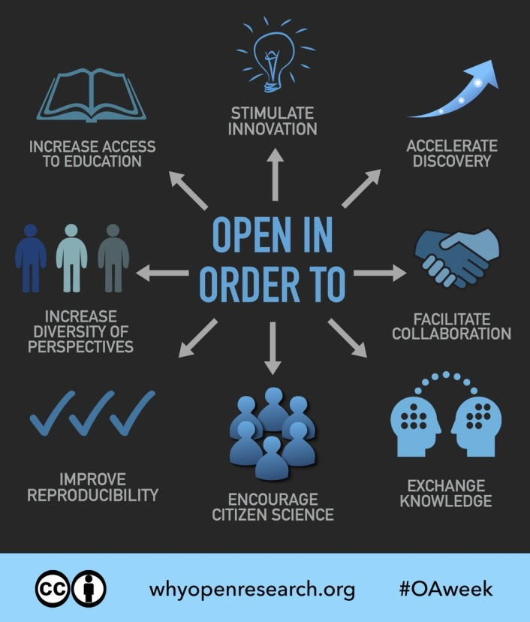
What does openness mean to us?
Quality
Efficiency
Reproducibility
Credibility
Visibility
“Open science is about improving the quality, accountability and social contribution of research…” (p. 96)
EC, 2016, DOI: 10.2777/061652
McKiernan, Erin (2017): OA Week graphics, "Open in order to...". figshare. Fileset. https://doi.org/10.6084/m9.figshare.5527900.v3
MLE on Open Science: Final Report -Altmetrics and Rewards (2018). https://rio.jrc.ec.europa.eu/en/library/mle-open-science-final-report-altmetrics-and-rewards
Notes:
I would like to make a proposal here:
We could take a different approach and start from the goals we want to achieve with open science, with what we can accomplish by sharing our work as researchers – instead of starting from the research products and counting how many of them have reached a state of openness or that were produced in an open manner.
It is popularily stated that open science increases the quality of science and its efficiency – openness will make science more reproducible and it helps science gaining in credibility. It will promote integrity of research and engagement. And of course: openness increases the visibility of research resulting, amongst others, in increased use – which, of course, can be quantified in citation numbers or tweet numbers.
There are other proposed benefits, for example, open science supports exchanging knowledge, stimulating innovation, facilitating collaboration and accelerating discovery.
I haven‘t seen much discussion or approaches and indicators that are seriously taking these aspects into account.
Of course, some may argue that by doing open science, science automatically becomes more reproducible or more credible.
But I doubt that this is where we really want to end with the open science movement.
I think the concept of ‚open science‘ includes more than that.
I guess the question we should ask is then, what is the quality of open science? What are the values of research we want to pursue if everything is 100% open?

Slide 14
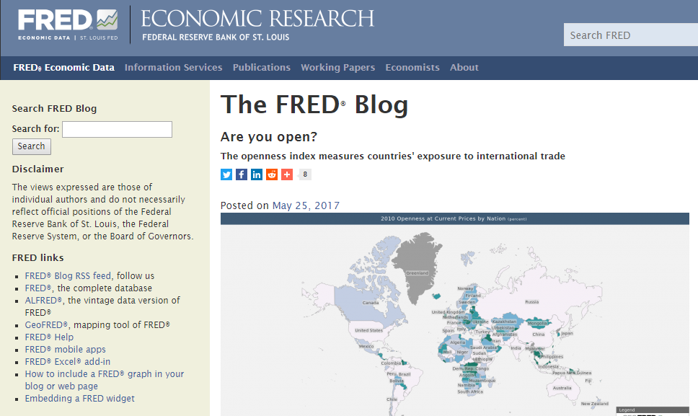
What does openness mean to us?
Openness Index
Import + export
GDP
https://fredblog.stlouisfed.org/2017/05/are-you-open/
Notes:
Are there any economists in the room?
Then they can help me out perhaps.
Let‘s take some of the benefits of open science, for example, that it supports exchanging knowledge and facilitating collaboration.
For me quite as a surprise, I found out that the economists may have an answer to how we should measure openness.
When you google: how to measure openness? you arrive at the openness index, which adds imports and exports in goods and services and divides this sum by GDP. The larger the ratio, the more the country is exposed to international trade. (Often the largest economies are the least open by this definition. Because they are so large, much of their trade is internal.)
We could easyily transfer this idea to the output indicators and could calculate an openness index on disciplinary basis, for co-authors and so force.
Of course, the result of this excercise is a number or ratio, but it may quite well represent the outcome of knowledge exchange or collaboration.
Maybe this economic definition of openness comes closer to what we think openness means? Maybe this indicator was translated to research assessment already and just not used? I am not aware of it.
We have to ask:
Is this a good measurement of open science? I don’t know.
Is this enough measurement for the values of open science? I think: no. Because…(next slide: Repeatedly the question of what open science really means to us and whether it can be expressed by a number shines through when we are discussing indicators, measuring frameworks and so on.)
GDP=value of all goods that are produced in one country

Slide 15
What does openness mean to us?
It is a chance to reorganize the science system
“…this MLE was dedicated to discussing core challenges […] when redesigning how scientific quality and impact is assessed, and which incentives and rewards should be developed to gradually replace a self-referential and hypercompetitive system, which has both harmed scientific integrity and discouraged social engagement” (p. 22).
…”opportunity to reorganise […] challenging some of the unfair and unproductive aspects of current research and evaluation practice” (p. 96).
MLE on Open Science: Final Report -Altmetrics and Rewards (2018). https://rio.jrc.ec.europa.eu/en/library/mle-open-science-final-report-altmetrics-and-rewards
Notes:
And, repeatedly the question of what open science really means to us and whether it can be expressed by a number shines through when we are discussing indicators, measuring frameworks and so on.
Apparently, Open Science seems to be the chance to tackle more pressing problems in the science system and to change the culture of science.
The quotes extracted from the Mutual Learning Excercise reveal that reseachers perceive the science system as unfair (which might not be the biggest surprise) and that there is hope that open science can „replace a self-referential and hypercompetitive system, which has both harmed scientific integrity and discouraged social engagement”. (end of quote)
So, what to do about it?
And again: do we measure what matters in open science with the indicators and frameworks proposed?

Slide 16
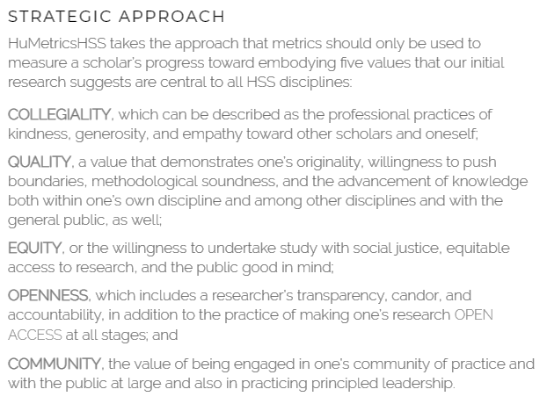

What does openness mean to us?
https://humetricshss.org/
Notes:
To give you an example of other types of metrics I would like to introduce the Humane Metrics Initiative that has been started by colleagues.
They aim at rethinking humane indicators of excellence in the humanities and social sciences – although I don’t think that this restriction to those few disciplines is necessary.
Humetrics has set out to create and support a values-based framework for understanding and evaluating all aspects of the scholarly life well-lived and for promoting the nurturing of these values in scholarly practice.
The framework identified values, such as collegiality, quality, equity, openness and community that are worth pursuing in academic life – and towards which academia should strive.
Can we think of such aspects for open science? Would they be different at all?

Slide 17
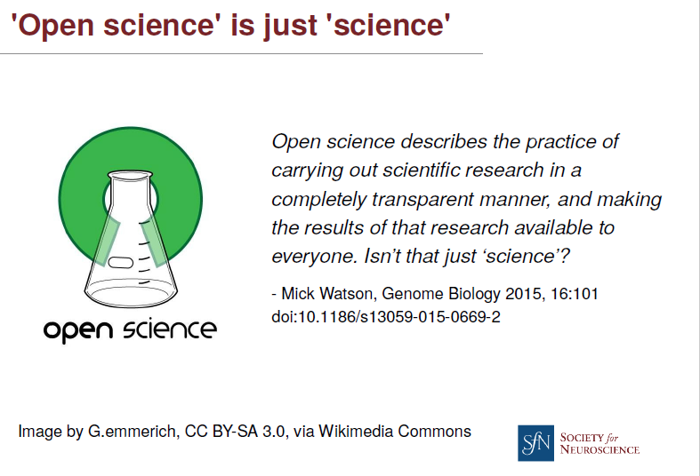
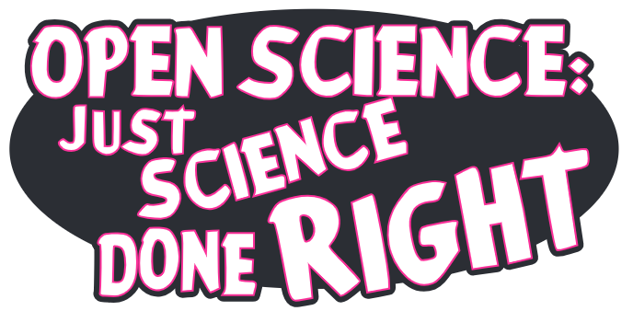
What does openness mean to us?
McKiernan, E. (2015). Sharing in science: Openness as a solution to improve reproducibility. figshare. Presentation. https://doi.org/10.6084/m9.figshare.1579268.v1
Imming, M. & Tennant, J.(2018, June 8). Sticker open science: just science done right. Zenodo. http://doi.org/10.5281/zenodo.1285575
Notes:
I totally agree with this statement from Mick Watson and the popular sticker from John Tennant (which I haven‘t managed to put on my laptop yet).
Open Science is science done right.
And if it is so, and open science doesn‘t change anything in terms of output, performance, structure and the process of research…..what is left then?
Or: May it be „just“ the chance to make science a better environment to better be able to contribute to a better world?
I do not want to sound overly pathetic or even naive here.

Slide 18
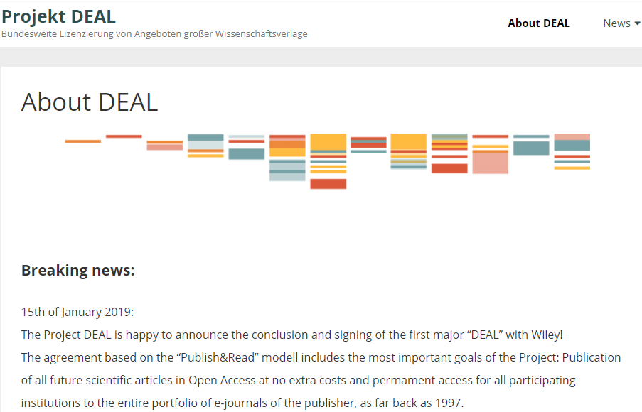
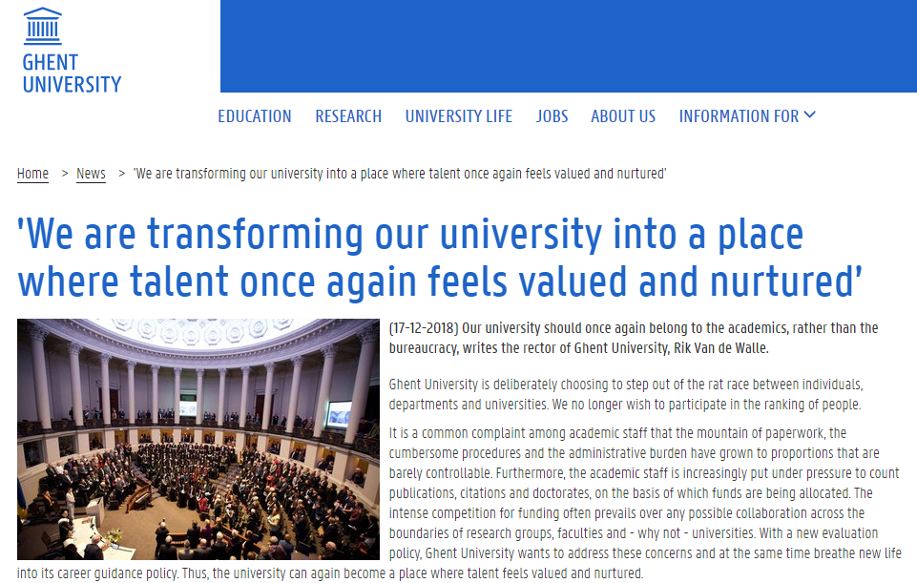
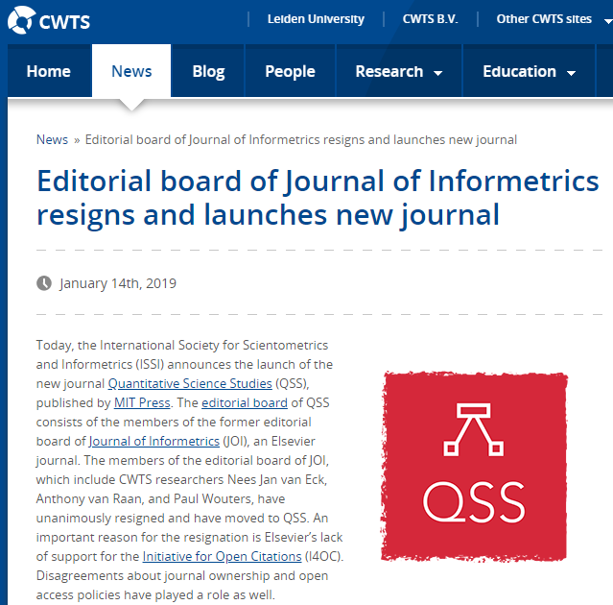
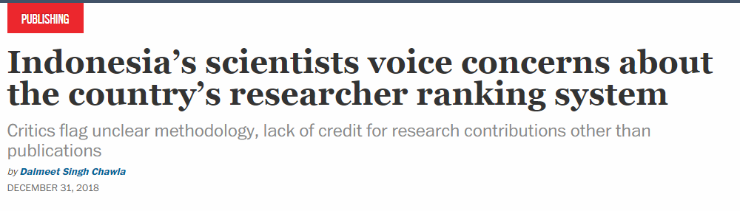
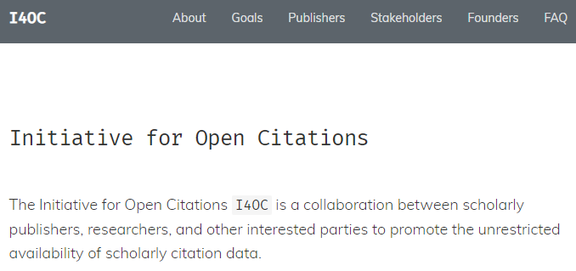
What does openness mean to us?
https://www.cwts.nl/news?article=n-r2v294&title=editorial-board-of-journal-of-informetrics-resigns-and-launches-new-journal
https://www.ugent.be/en/news-events/ghent-university-talent-rat-race-transformation-career-evaluation-model.htm
https://cen.acs.org/policy/publishing/Indonesias-scientists-voice-concerns-countrys/96/web/2018/12
https://www.projekt-deal.de/about-deal/
Notes:
But there is evidence that researchers and research institutions take open science measures serious – they take them even literal – and that is as prompts for actions.
Researchers openly raise concerns about ranking systems, editorial boards step down and launch open access journals, universities try out assessments schemes in which talent once again feels valued and nurtured, long-standing monopolies on citation data are challenged as well as on publications.
For me, these are great examples of value-based measures and practices of open science.

Slide 19
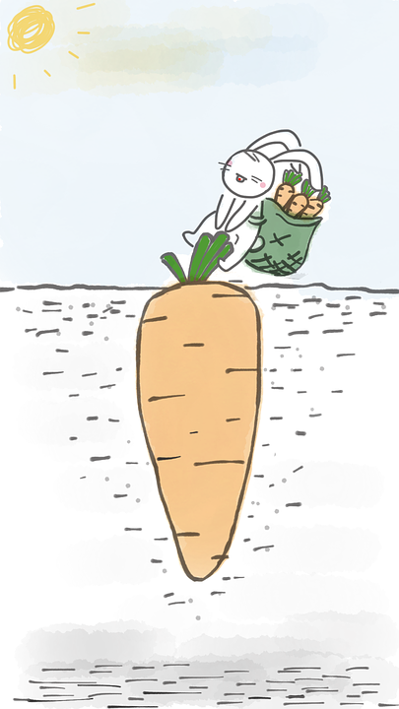
Conclusion I
Measure what matters
What are good carrots?
Notes:
Now: How to conclude such a presentation?
I have two points to make.
In a way I am sick of counting and measurements.
I understand that indicators are needed as incentives in the transition phase between two ways of doing science – until we reach 100% of openness.
Also, incentives make sure that we do not forget anything important, for example, that there are new research products that should count as evidence of research that has taken place. Or as presumably Albert Einstein has put it: „Not everything that counts can be counted, and not everything that can be counted counts.”
---KLICK-- Maybe we should not talk anymore of counting in the sense of measuring but of counting in the sense of reflecting on properties that we value.
However, I am not convinced that science becomes better if we only implement more and more measurements, indicators, evaluation frameworks – you name it.
I neither believe that the only incentive the science system can generate is competition and measurements and indicators.
There are so many smart people out there…..where are the new ideas?
---KLICK---
But if such quantifiable incentives are the only measures that work than I would prefer rushing towards the right (good) carrots, than those that may cause stomach aches, I mean, adverse effects by unintentionally hunting numbers. But for this we have to know what are the good carrots – and as I have shown you this still needs some discussion.

Slide 20

Conclusion II
Foundations for Open Scholarship Strategy
Development: https://open-scholarship-strategy.github.io/site/
Notes:
The second point I want to make is this: ---KLICK---
If you google for the word „openness“, this is what is shown (at least this shows up when I google it).
For me, those open arms perfectly visualize what open science is about:
You need open arms to start embracing new ideas, new practices and to welcome collaboration, exchange and to provide access.
The writings of the Foundations for Open Scholarship Strategy Development say this quite nicely:
„The core principles or values of Open Scholarship include participation, equality, transparency, cognitive justice, collaboration, sharing, equity, and inclusivity; aspects that are often missing from traditional scholarship. Generally, it is agreed upon that the combination of these practices and principles will result in a better research process, all grouped under the broad heading of Open Scholarship.” (end of quote)
But you also need open arms to let go: let go of traditions, of crusty structures, of „we have always done it like that‘, and of „I also had to go through this to become an excellent researcher“.
Open Science is open science.

Slide 21
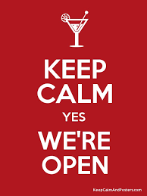
Questions?
Approaches to
Measuring
Openness
Isabella Peters,
i.peters@zbw.eu
Notes:
Thank you.

